Slide 1

Text-Video Matching
Text-video retrieval(TVR)
T2V/V2T
2022-10-28
xiahou

Slide 2
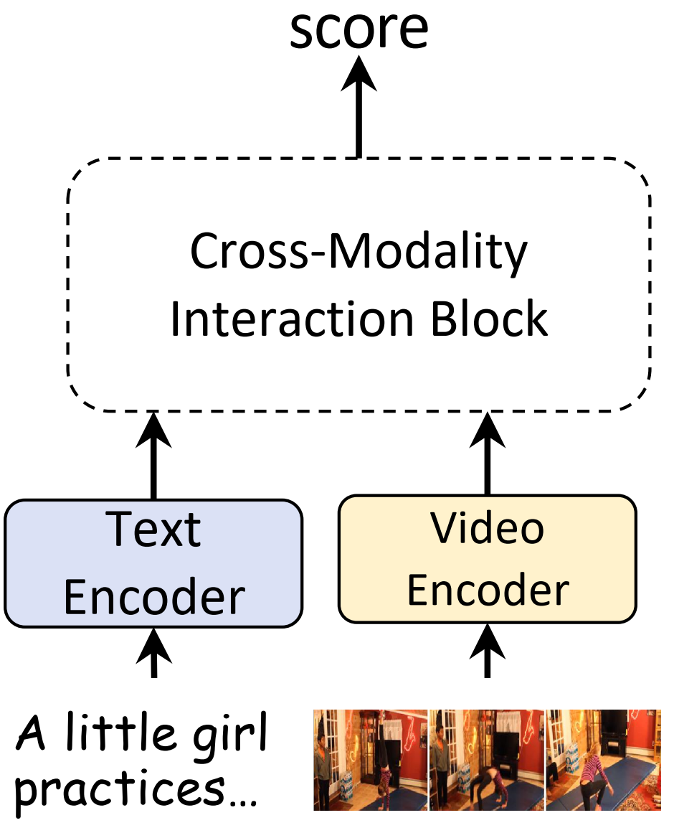

任务简介
任务定义：In text-video retrieval, the objective is to learn a crossmodal similarity function between a text and a video that ranks relevant text-video pairs higher than irrelevant pairs.
${Sim}_{relevant}$ >${ Sim}_{irrelevant}$
Video-text Vs Image-text
相同点：
matching framework
regions/frames
feature aggregation
…
不同点：
Temporal
Sample
Audio&Speech
…

Slide 3
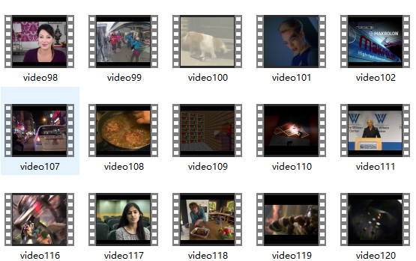
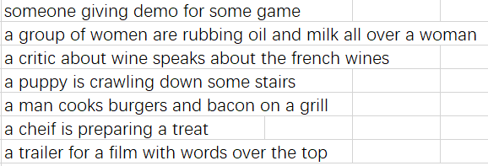
Datasets&Metrics&SOTA
数据集：MSR-VTT、MSVD、LSMDC、DiDeMo、ActivityNet、VATEX、TGIF、HowTo100M …
MSR-VTT
10k video，each paired with 20 captions，10s-32s
度量：Recall@1，Recall@5，Median Rank，Mean Rank
SOTA：X-Pool R@1 46.9 on MST-VTT-9k dataset

Slide 4
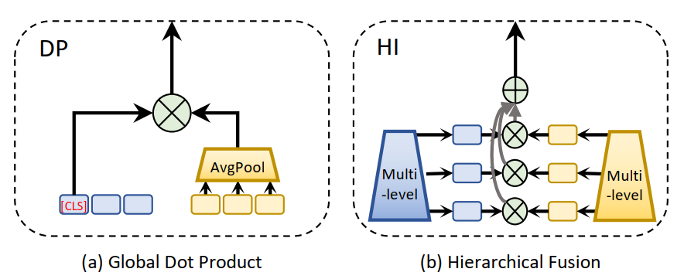

Retrieval architecture1
Dual model vs Jiont model
CLIP4Clip: An Empirical study of CLIP for End to End Video Clip Retrieval. ArXiv.2021
Frozen in Time: A joint Video and Image Encoder for End-to-End Retrieval. ICCV.2021.
X-CLIP: End-to-End Multi-grained Contrastive Learning for Video-Text Retrieval.MM.2022
Single-level similarity
Aggregator：avg、max、attention、network
Dual Encoding for Video Retrieval by Text.TPAMI.2021
Similarity：cosine
Fine-grained Video-Text Retrieval with Hierarchical Graph Reasoning.CVPR.2020
Multi-level similarity
Fine-grained，coarse-grained
Multi-view
Sentence，object，relationship，attribute
Visual，audio，speech
…
Multi-modal Transformer for Video Retrieval.ECCV.2020
推理效率高
缺乏模态交融，聚合没有guide

Slide 5
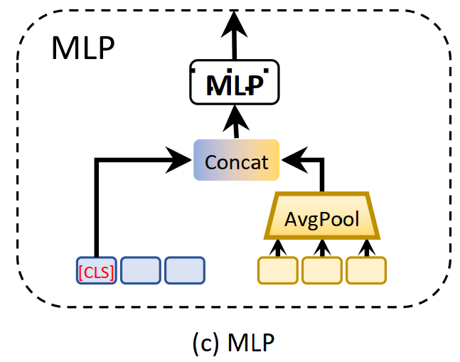
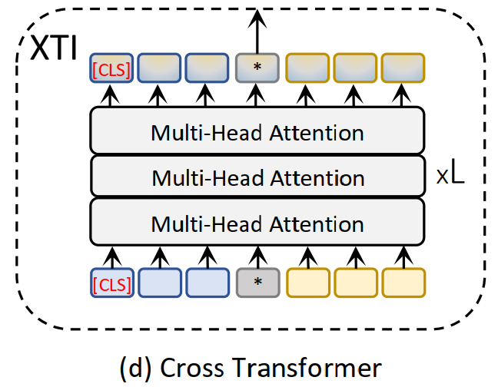
Retrieval architecture2
Dual model vs Jiont model
X-Pool: Cross-Modal Language-Video Attention for Text-Video Retrieval. CVPR. 2022
Video and Text Matching with Conditioned Embeddings. WACV.2022
Everything at Once: Multi-modal Fusion Transformer for Video Retrieval.CVPR.2022
Aim to:
Less is More: ClipBERT for Video-and-language Learning via Sparse Sampling.CVPR.2021
Text conditioned/guide video feature
Multi-modal fusion
Temporal Alignment Networks for long-term Video. CVPR.2022
有导向性，有交融
推理效率低
Visual Consensus Modeling for Video-Text Retrieval. AAAI.2022
Use a high recall method to obtain a set of top retrieval candidates.
Bridge
Bridging Video-text Retrieval with Multiple Choice Question. CVPR.2022

Slide 6
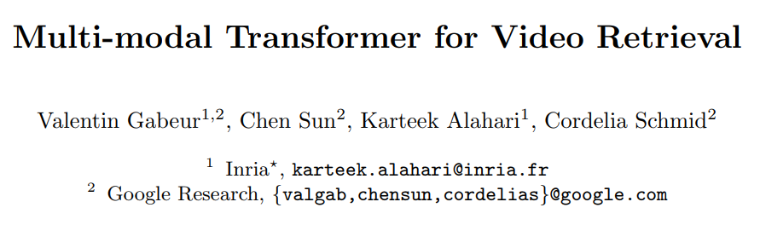
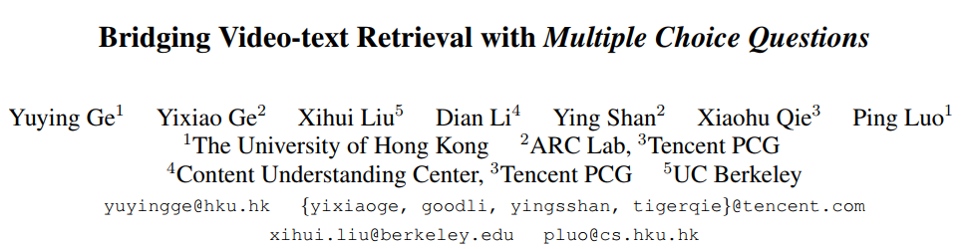
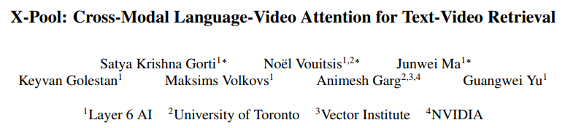
论文:
Dual model
ECCV 2020
Mixture of Experts（MoE）
Joint model
CVPR 2022
Bridge
Joint model
CVPR 2022
SOTA
Notes:
MMT

Slide 7
论文1:
Motivation :
Existing methods do not fully exploit cross-modal cues present in video. cross-modal → visual, audio, speech
They aggregate per-frame visual feature with limited or no temporal information.
Method :
Jointly encode the different modalities in video. Allow them to attend to the others.
Encode and model the temporal information.

Slide 8
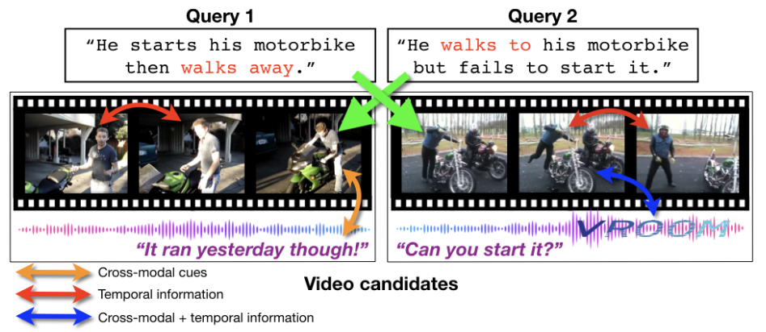
论文1:
Multi-modal Transformer for Video Retrieval
Motivation:
Why temporal information & Why cross-modal cues
Without temporal information, walk away? Walk to?
Without cross-modal cues, start? Fail to start?
Another example: a crowd listening to a talk.

Slide 9
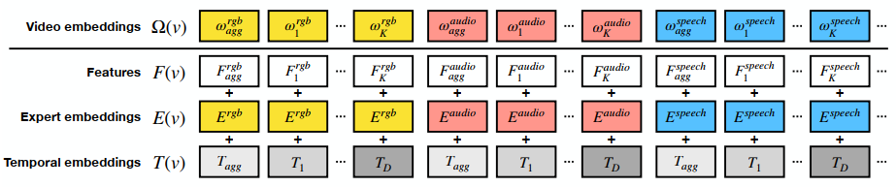

论文1:
Multi-modal Transformer for Video Retrieval
Method:
How temporal information & How cross-modal cues
Feature F(v):
Each expert is a model
trained for a particular task.
Expert embedding:
N learnable embedding
Temporal embedding：
Transformer temporal embedding
S3D → Motion features
VGGish → Audio features
GCS → Speech features
…

Slide 10
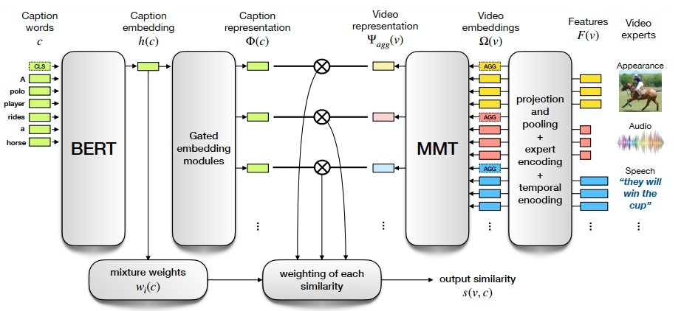
论文1:
Multi-modal Transformer for Video Retrieval
Method:
How temporal information & How cross-modal cues
Caption里包含了是否需要利用某些模态的信息
A person in a red dress.
Someone is singing.

Slide 11
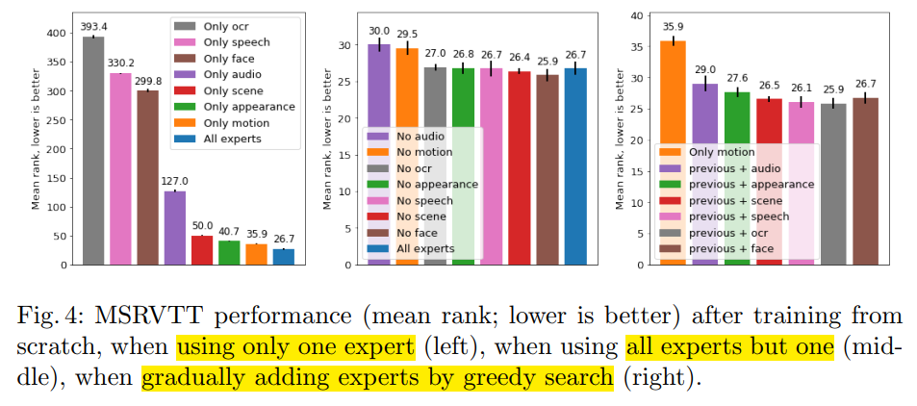
论文1:
Multi-modal Transformer for Video Retrieval
Experiments：
OCR：视频里的文本(如字幕之类的）的特征
OCR、speech、face单独使用时效果很差；scene、appearance、motion单独使用效果可观。
剔除任何一个expert，性能都还不错，说明multi-modal特征之间有很多overlap。
Audio单独使用效果一般，跟视觉特征结合效果较好，相互补充。
Notes:
总结：
双流multi-level模型
模型结构没有花哨的，核心在构建video feature
探索性工作
缺少temporal消融实验

Slide 12
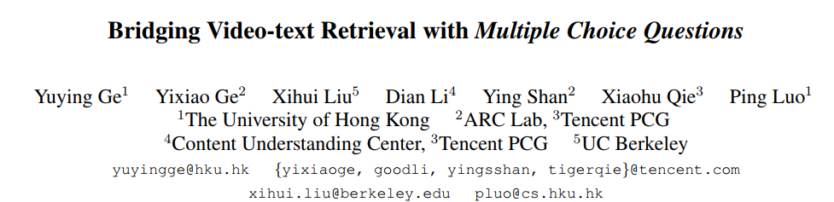
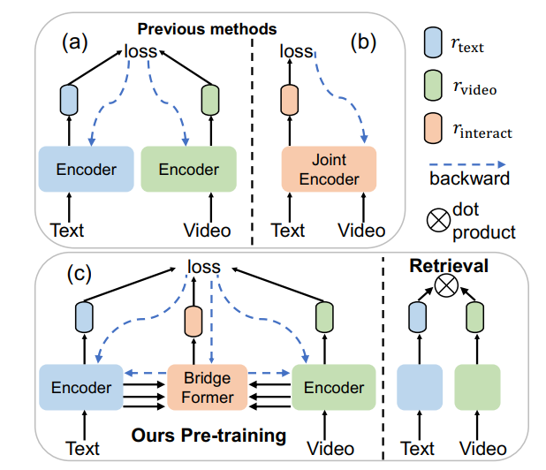
论文2:
Bridging Video-Text Retrieval with Multiple Choice Questions
motivation：
在dual-model或joint-model里，fine-grained interactions和high retrieval efficiency不可兼得
引入a pretext task(MCQ)和a new module(Bridgeformer)
实现训练时能细粒度交融，推理时能高效推理

Slide 13
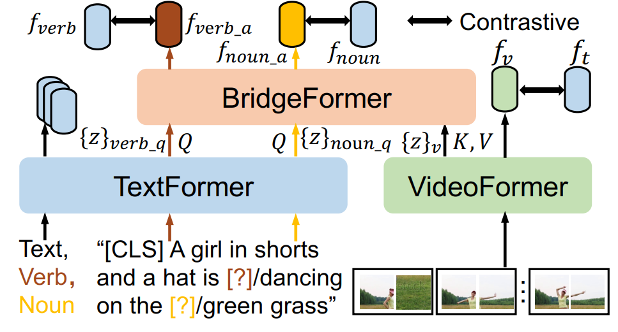
论文2:
Bridging Video-Text Retrieval with Multiple Choice Questions
Multiple Choice Questions：
Pretext task → Contrastive object
Noun和verb往往包含丰富的语义信息
将text里的noun或verb剔除。
剔除n和v之后的text用textformer提取特征，
同视频特征一并输入到bridgeformer，输出
预测的answer。
被剔除的n和v同样用textformer提取特征，
要求在一个batch内，answer和被剔除的n或
v最相近。
n和v被剔除了，要预测它需要从visual feature中提取细粒度的信息，以此进行细粒度的交融
Notes:
大家对MCQ有什么疑惑

Slide 14
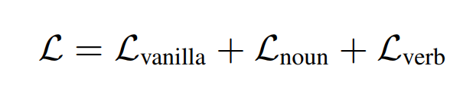
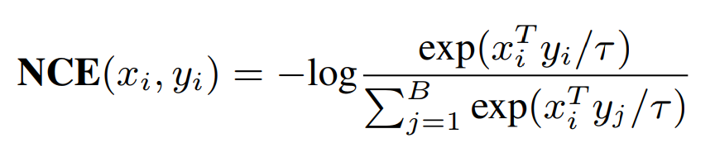
论文2:
Bridging Video-Text Retrieval with Multiple Choice Questions
Multiple Choice Questions：
Pretext task → Contrastive object
Object：

Slide 15
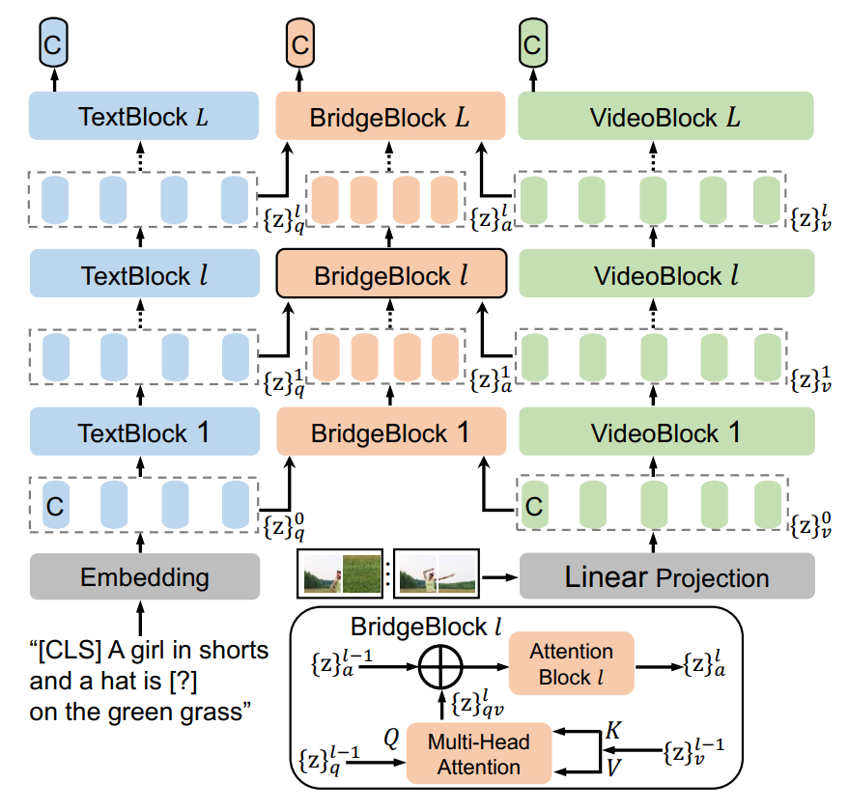
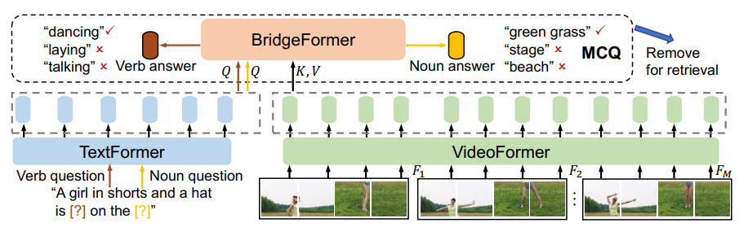
论文2:
Bridging Video-Text Retrieval with Multiple Choice Questions
Model Architecture：
Videoblock adopts ViT
Textblock adopts transformer
多层交融

Slide 16
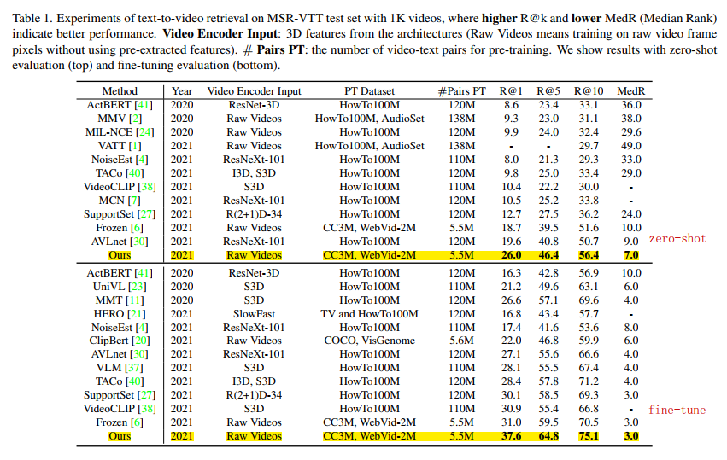
论文2:
Bridging Video-Text Retrieval with Multiple Choice Questions
Experiment：
Input：raw video
没有backbone
计算量更少
预训练数据更少，
性能更高
Pre-train的T2V工作：
25 hours using 40 A100

Slide 17
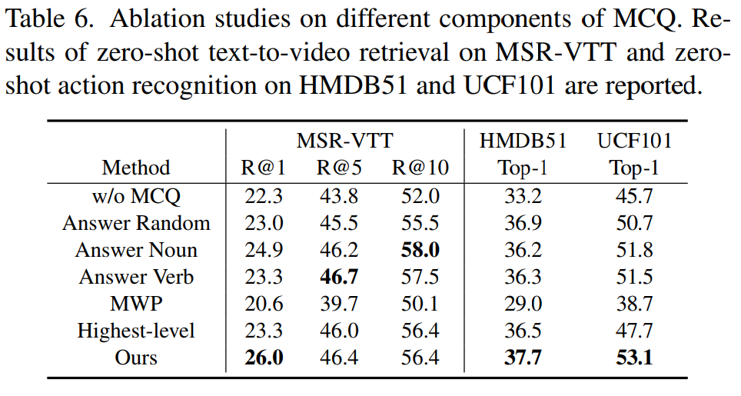
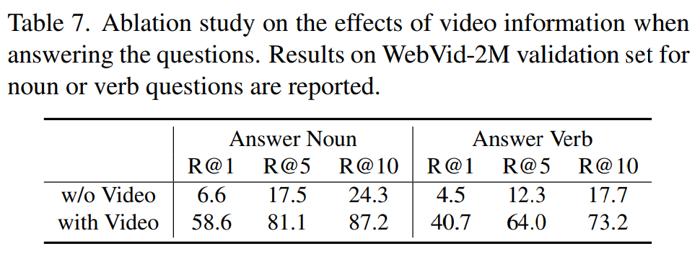
论文2:
Bridging Video-Text Retrieval with Multiple Choice Questions
Ablation Experiment：
去掉bridgeformer(双流模型) ↓
随机剔除单词 ↓
只剔除noun或者verb ↓
MWP预测answer不是contrastive object，改成Masked Word Prediction ↓
只对highest-level进行交融，而不是多层交融 ↓
Do Video help to answer questions？
预测answer的时候，只用剔除了n和v的文本信息
Notes:
总结
预训练工作
bridge

Slide 18
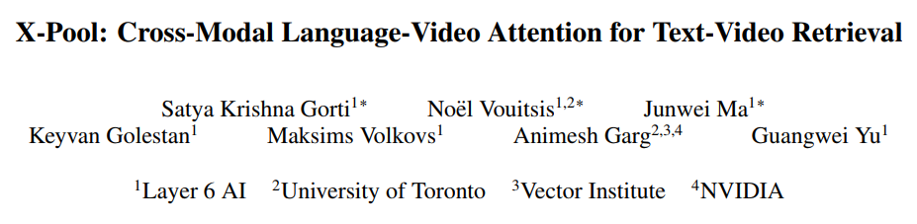
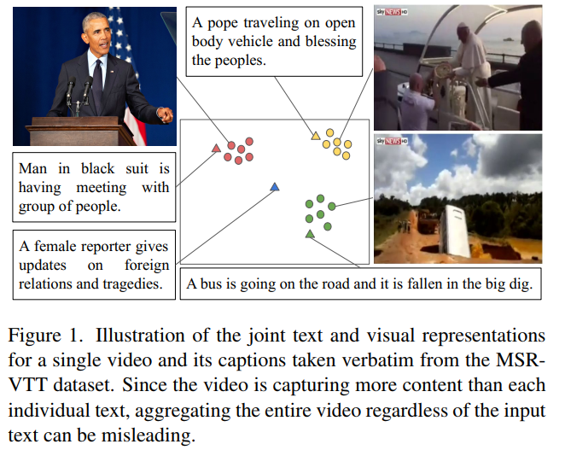
论文3:
X-pool：Cross-Modal Language-Video Attention for Text-Video Retrieval
2022 CVPR 结构简单、性能SOTA
Motivation：
视频一般包含更丰富的语义(如多场景)，caption往往只描述其中一部分的语义
Model should focus on the text‘s most semantically similar sub-regions.
现有的方法大多是text-agnostic aggregation，容易聚合到一些冗余或无关的信息

Slide 19
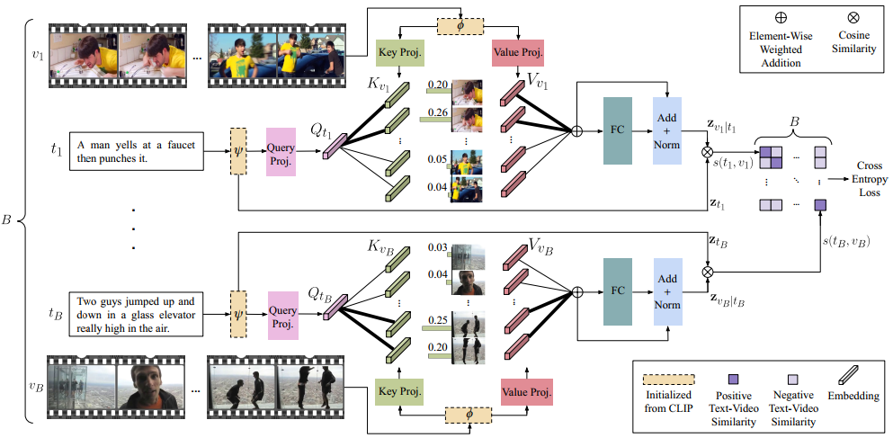
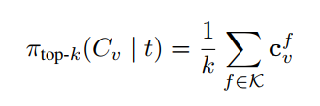
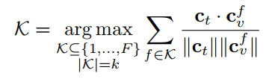
论文3:
X-pool：Cross-Modal Language-Video Attention for Text-Video Retrieval
Method：
Text-conditioned video embedding
对比聚合方式：
meaning-pooling
Top-k text-conditioned pooling

Slide 20
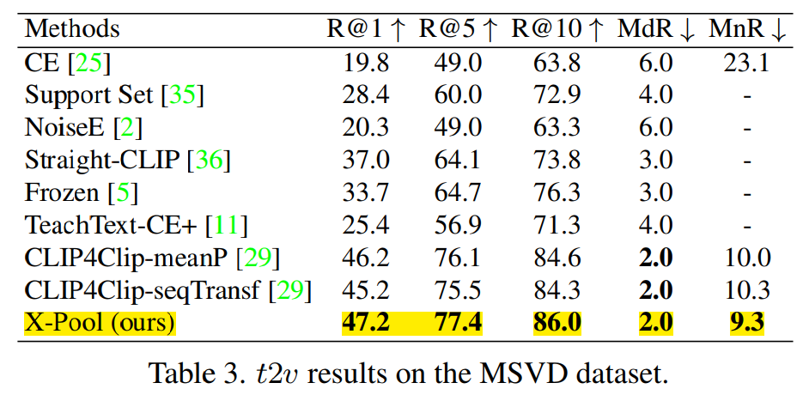
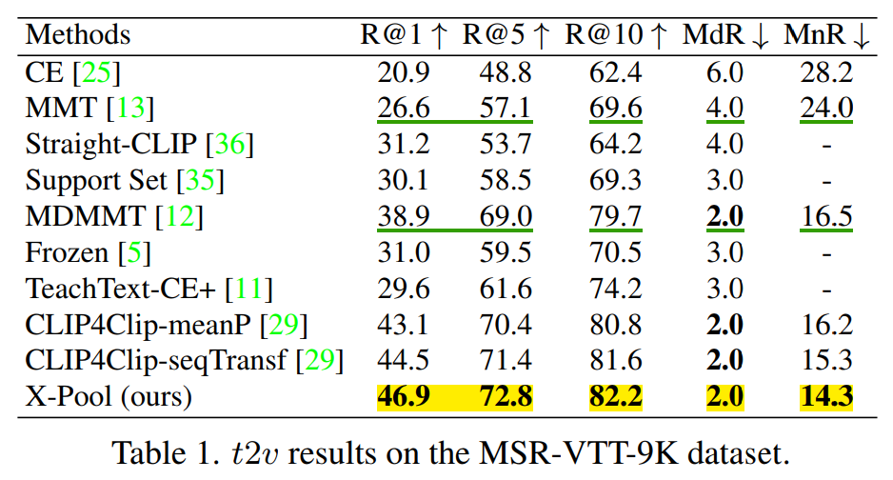
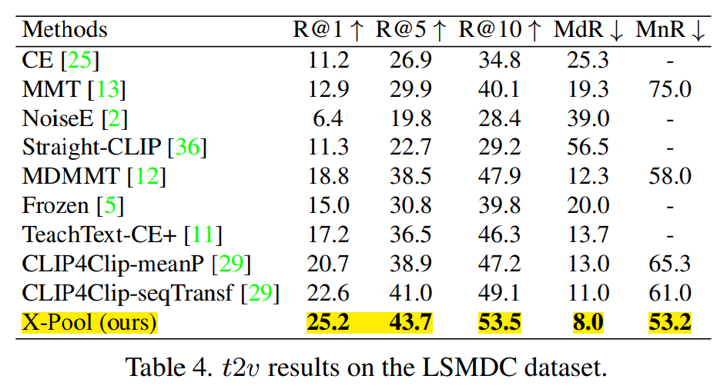
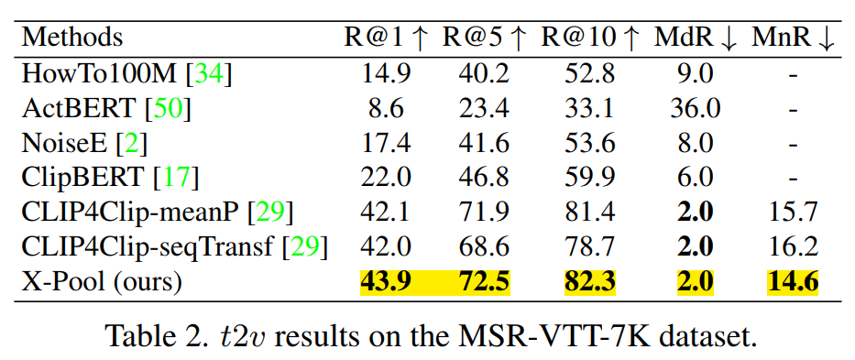
论文3:
X-pool：Cross-Modal Language-Video Attention for Text-Video Retrieval
Experiment：
Comparison with State-of-the-art Methods

Slide 21
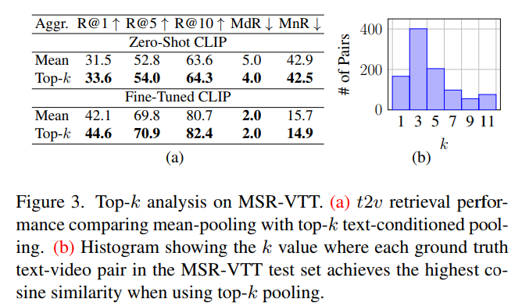
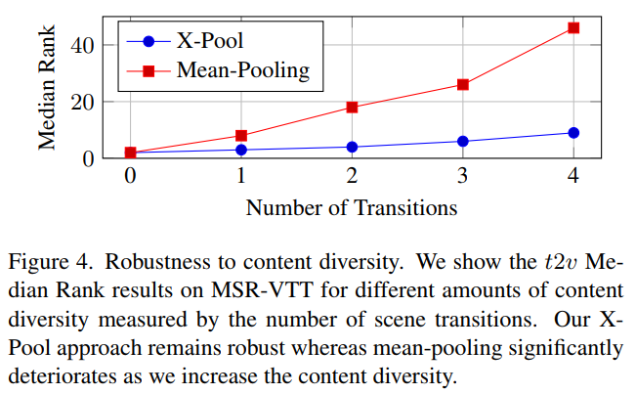
论文3:
X-pool：Cross-Modal Language-Video Attention for Text-Video Retrieval
Experiment：
Ablations
结论：
从(a) → top-k有效，验证了motivation的正确性
从(b) → 预选择一个k总是次优的，需要attention
Xpool具备视频场景多样化的鲁棒性
Notes:
总结
CLIP

Slide 22
Text-Video Retrieval总结
CE、MMT、SSB、Frozen…
2021 CLIP4clip
X-pool、X-CLIP、VCM…
模型设计方向：
设计模型(backbone是RCNN、S3D），没有预训练
利用多模态信息：Mixture of Experts(MoE)
设计模型，视频数据集预训练
…
CLIP出现之后：
MoE少了，visual feature
T2V跟text-image matching更相似
预训练？
Temporal？
其他：
研究减少视频训练的计算量(训练策略）
离散语义表征
层级语义图
…

